Slide 1

A preprint server for the Earth and Planetary Sciences

Slide 2
A preprint is a version of a scholarly paper that precedes publication in a peer-reviewed journal, typically prior to the formal, journal-led peer review process
A preprint server, such as EarthArXiv, is a platform built to host preprints
Preprints are: (i) free to submit; (ii) fast to publish; (iii) open access; and (iv) established in many natural sciences

Slide 3
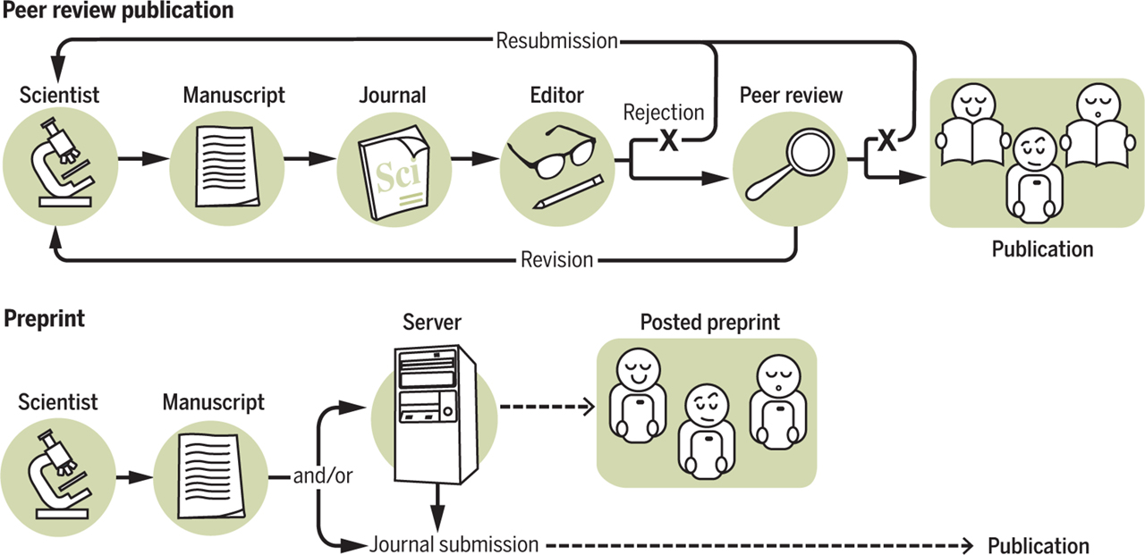
What’s a Preprint anyway?
Preprint
Feedback (‘independant’)
http://asapbio.org/asapbio-attendees-commentary-in-science
Feedback (‘journal-led’)

Slide 4
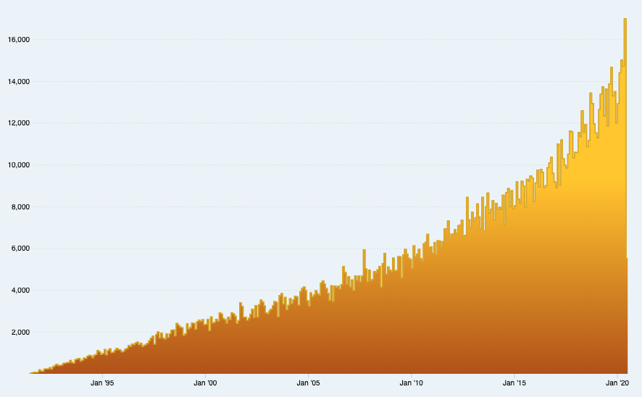

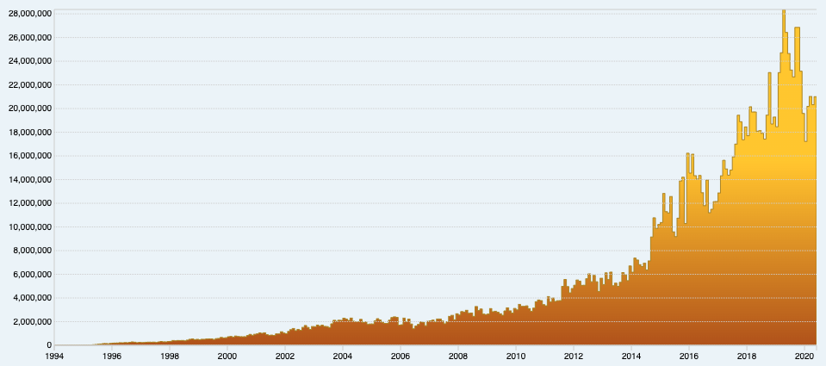
https://arxiv.org/stats/monthly_downloads
16,000
Are preprints new?
10,000
ArXiv started in 1991 by Paul Ginsparg (Los Alamos National Laboratory) for rapid communication of predominantly physics research
Now covers mathematics, physics, astronomy, computer science, quantitative biology, statistics, and quantitative finance
Today: >1.3 million total submissions; >1.6 billion total downloads; c.200,000 submissions per year; >20 million downloads per month
Monthly submissions
2000
Year
2010
https://arxiv.org/stats/monthly_submissions
20,000,000
Monthly downloads
10,000,000
2000
2010
2019
Year

Slide 5
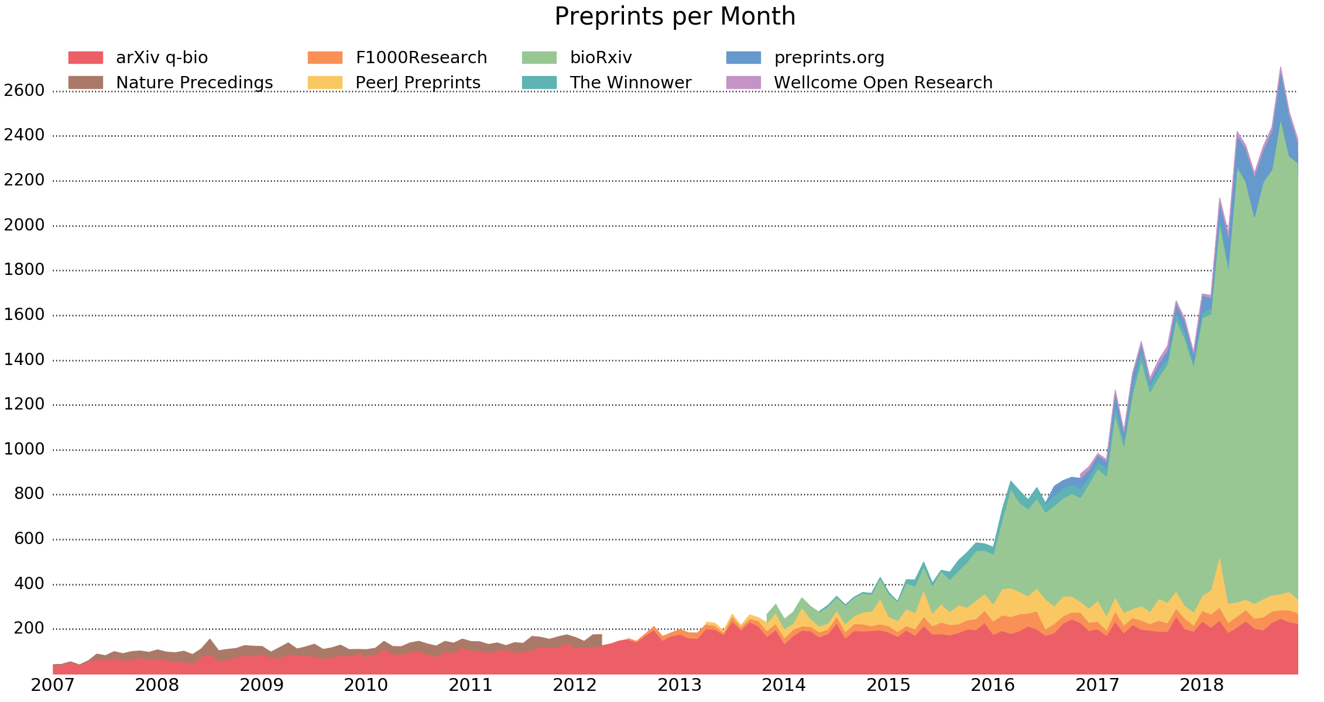





Preprint are not new!
Preprints based on various infrastructure models (e.g. journal- vs. community- vs. funder-led)
Preprints per month
Year

Slide 6
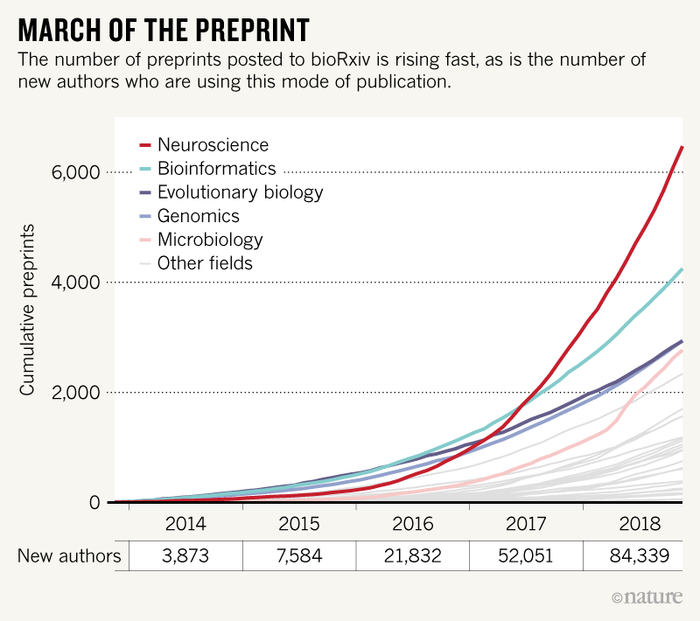
What bioRxiv's first 30,000 preprints reveal about biologists

Slide 7
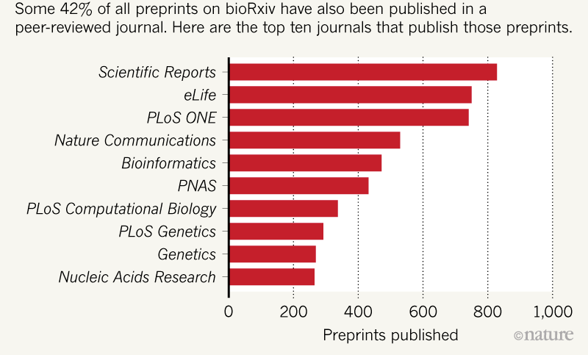
Preprints and publishing
https://www.nature.com/articles/d41586-019-00199-6

Slide 8
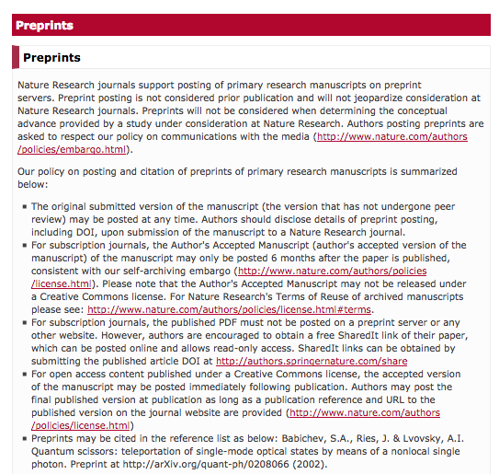


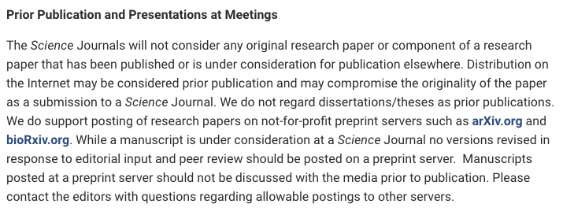

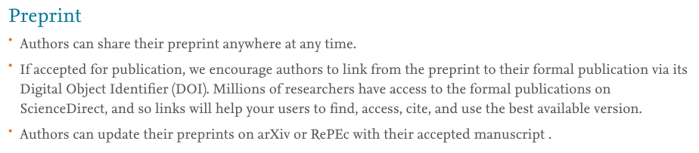
Preprints and publishing...
http://www.sciencemag.org/authors/science-journals-editorial-policies (Monday 13th July 2020)
https://www.nature.com/authors/policies/preprints.html?foxtrotcallback=true (Monday 13th July 2020)
https://www.elsevier.com/about/our-business/policies/sharing (Monday 13th July 2020)

Slide 9
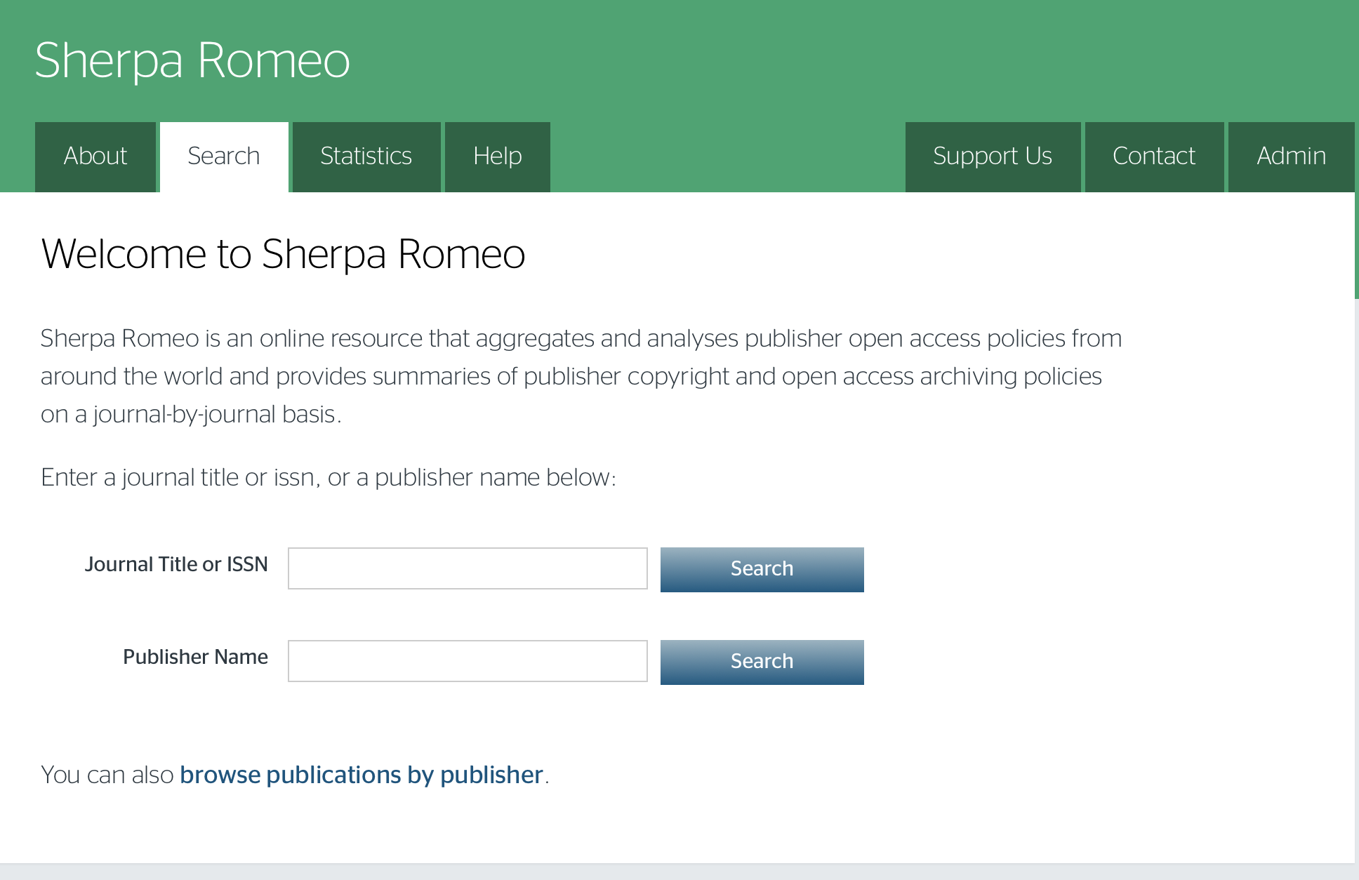

Preprints and publishing...
https://v2.sherpa.ac.uk/romeo/

Slide 10

EarthArXiv.org
A preprint server for Earth and Planetary Sciences
online since October 2017
1,567 contributions (as of June 2020)
c. 1600 downloads monthly
community driven & independent

Slide 11
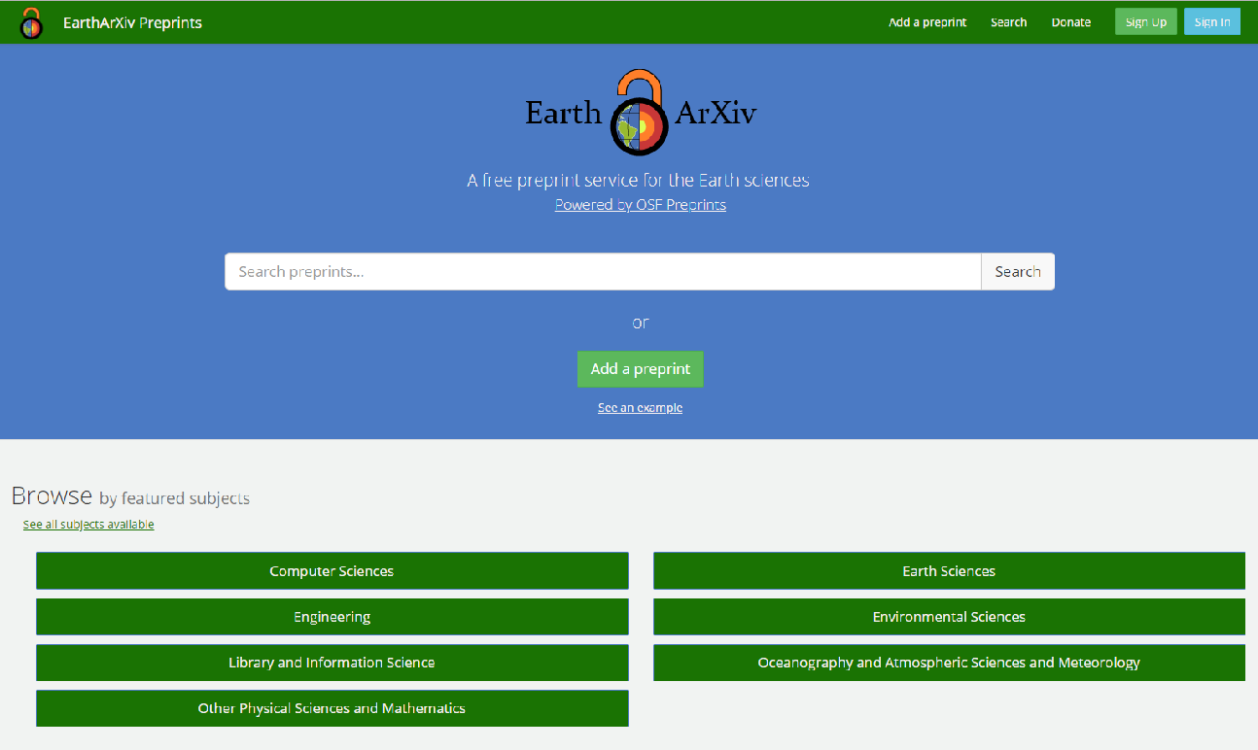
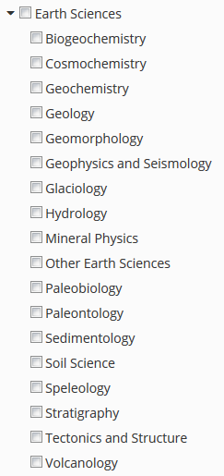
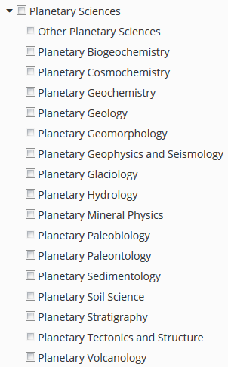
Earth Science
categories
Planetary Science
categories

Slide 12
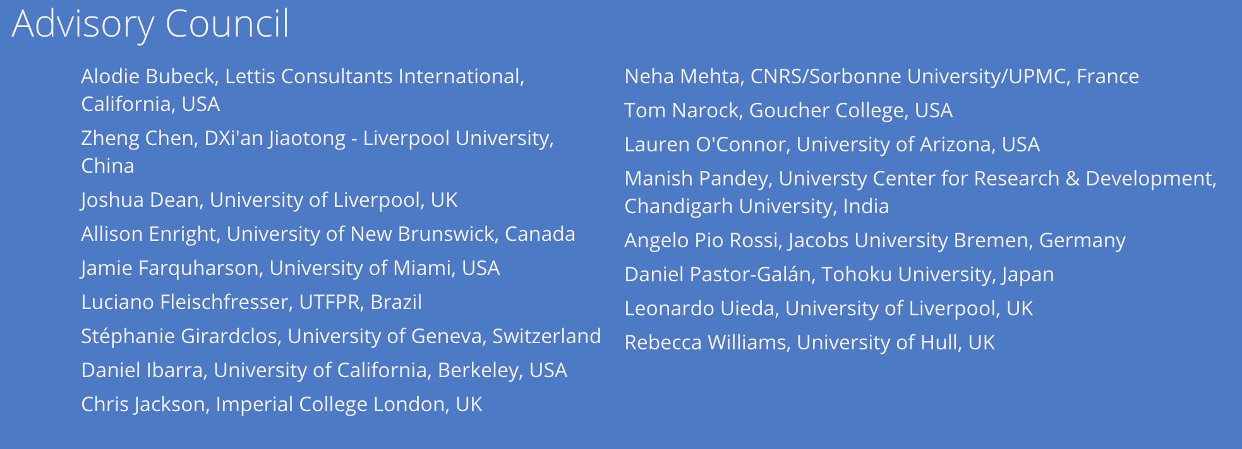
EarthArXiv.org - Organisation
community driven – everybody can get involved!

Slide 13

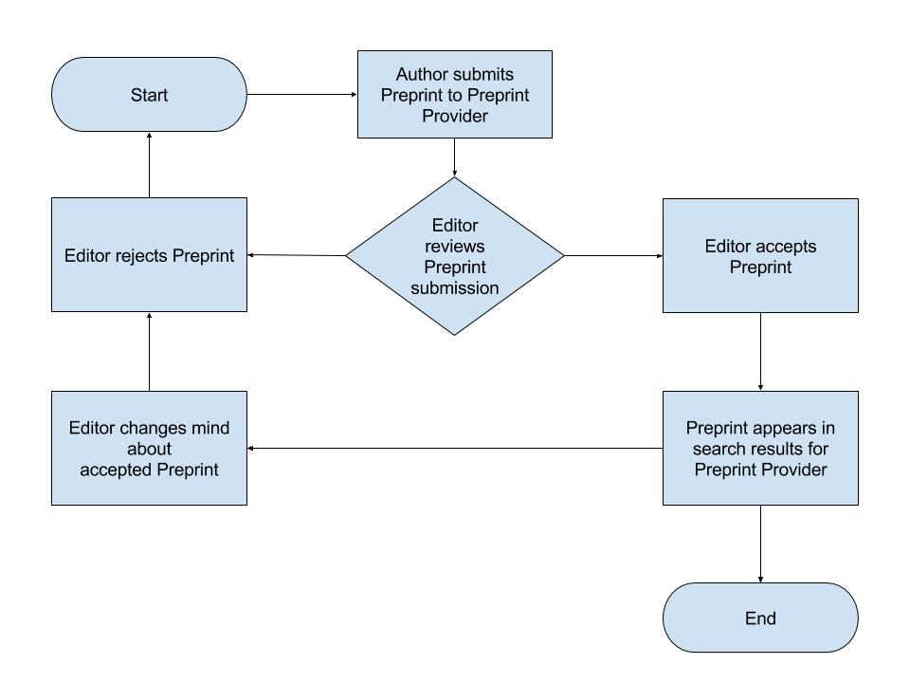
EarthArXiv.org
moderation policy
Pre-Moderation

Slide 14
EarthArXiv.org
moderation policy
What does EarthArXiv accept?
Research articles
Review papers
Case studies
Technical notes (e.g. new instrumentation or analysis methods)
Confirmatory studies
So-called ‘null’ results (i.e. results that not supporting a hypothesis)
Dataset description papers
What does EarthArXiv not accept?
Papers reading as a personal attack, airing of grievances, or insulting to a group/class of people. Racist and derogatory language will not be tolerated
Commentaries and opinion pieces
Posters (cf. ESSOAr)
Theses and course projects (see www.thesiscommons.org)
Software articles

Slide 15
EarthArXiv.org
moderation policy
Publication and hosting of your paper
Upon moderation, EarthArXiv agrees to publish your paper by assigning a DOI
EarthArXiv is not a journal and does not evaluate the scientific quality of a paper. Once a paper passes moderation and is published, it persists on the system indefinitely. N.B. EarthArXiv reserves the right to remove papers after publication if fraud or plagiarism is identified (see right).
EarthArXiv will provide free online hosting of your paper as long as it is operational
Fraud and Plagiarism
EarthArXiv takes fraud and plagiarism very seriously.
Should the Board deem fraud or plagiarism to have occurred, the paper will be immediately removed from EarthArXiv

Slide 16
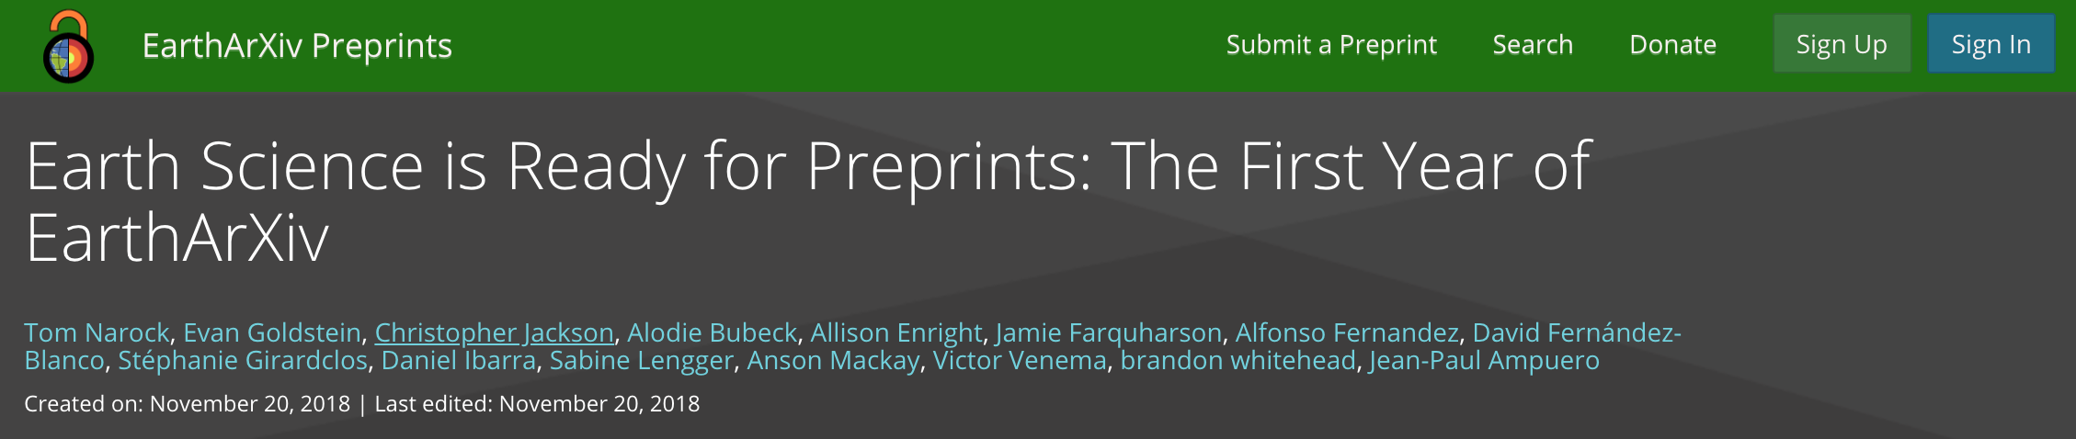
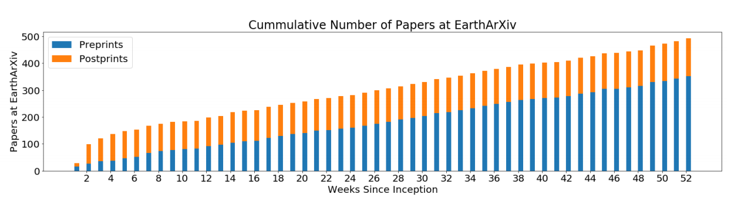
https://eartharxiv.org/kftsv/
Initially, postprints outnumbered preprints
By the end of year 1, EarthArXiv was (and remains) predominantly preprints
EarthArXiv averaged 40 submissions per month in its first year
Notes:
EarthArXiv is one year old and doing very well…

Slide 17
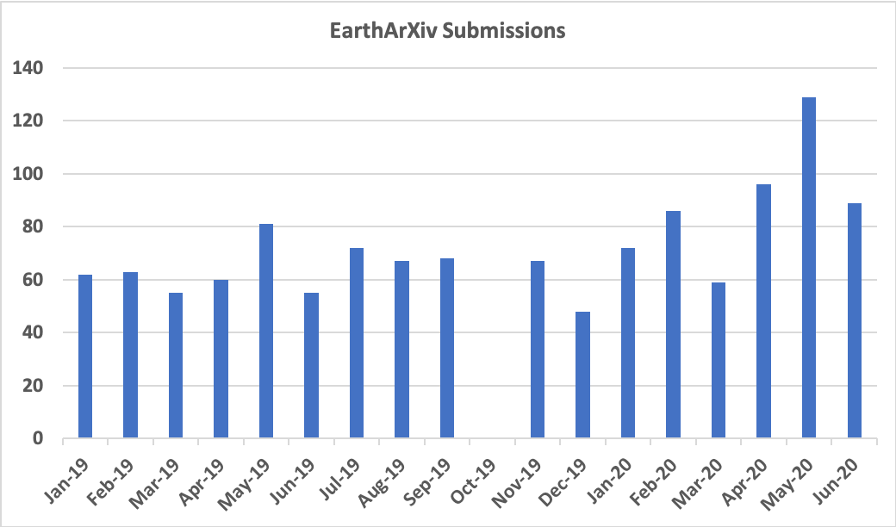
Since the first year...
Monthly submissions have increased from 40 to ~70
As of Fall 2019, 71% of the authors at EarthArXiv are distinct
This is slightly above other COS-based preprint communities which cluster between 57–69%

Slide 18
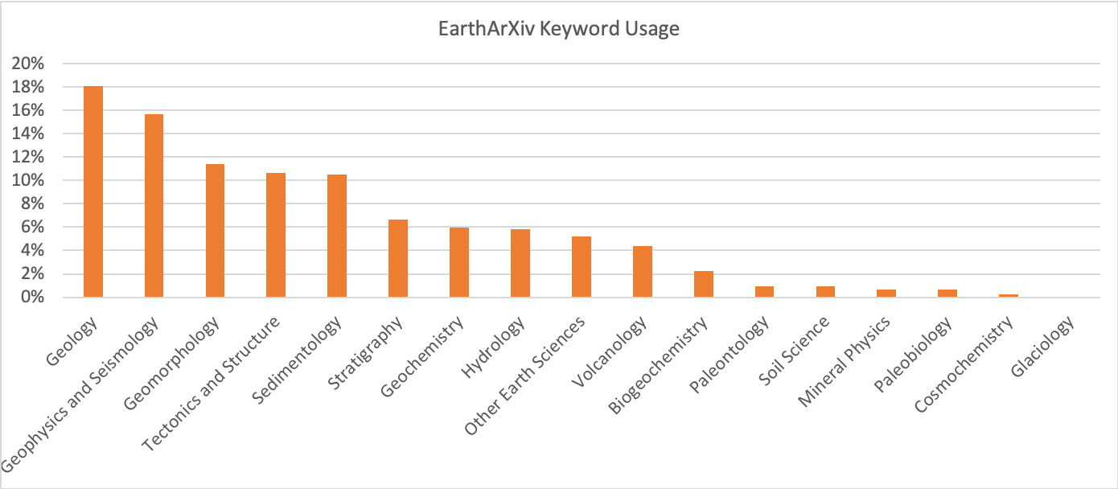
EarthArXiv Topics
As determined by author assigned keywords
(last updated Summer 2019)

Slide 19
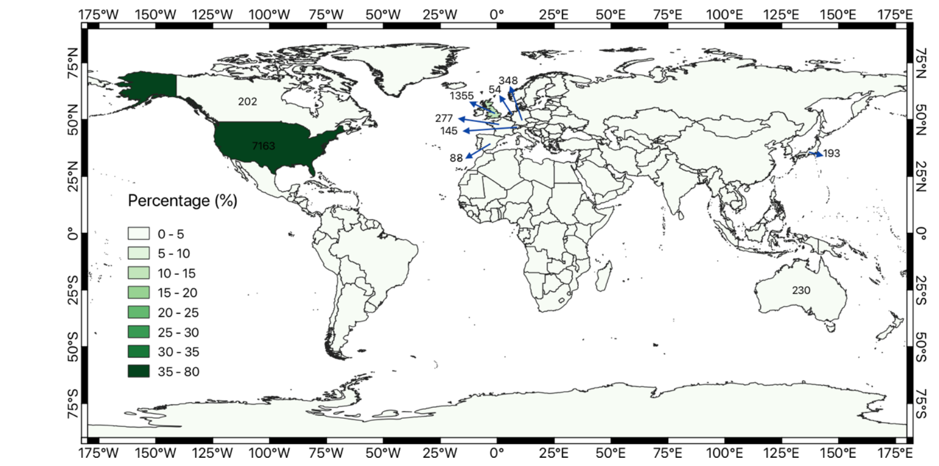
Notes:
Potential for global impact, but it’s important to think about why certain regions are not engaging; i.e. what is their incentive structure for being open?

Slide 20



@eartharxiv
Join us, follow us!
Be part of an OPEN community!

Slide 21
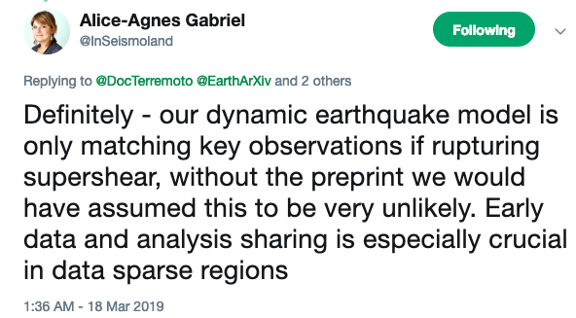
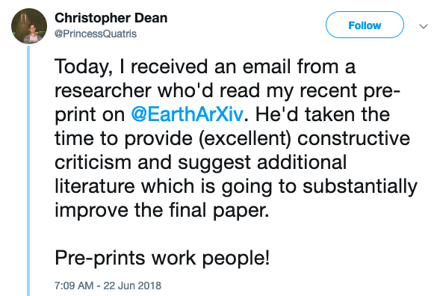
@eartharxiv
Join us, follow us!
Make your work BETTER!
Preprints lead to feedback
& improve your work

Slide 22
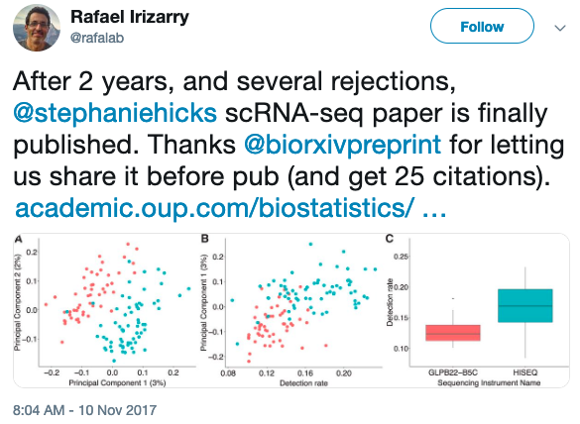
@eartharxiv
Join us, follow us!
Make your work VISIBLE!
Preprints have a
DOI & are citable

Slide 23
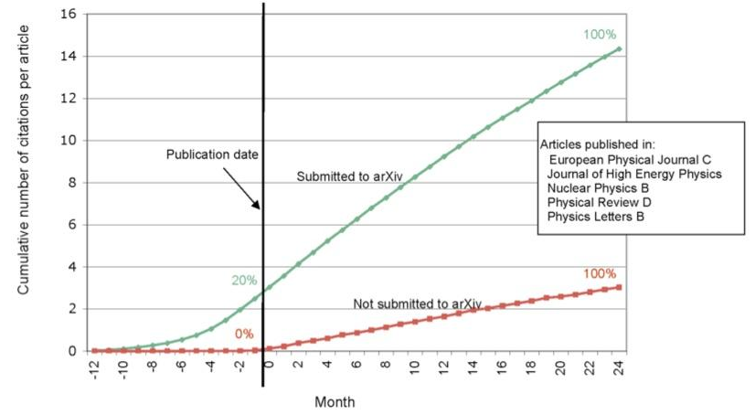
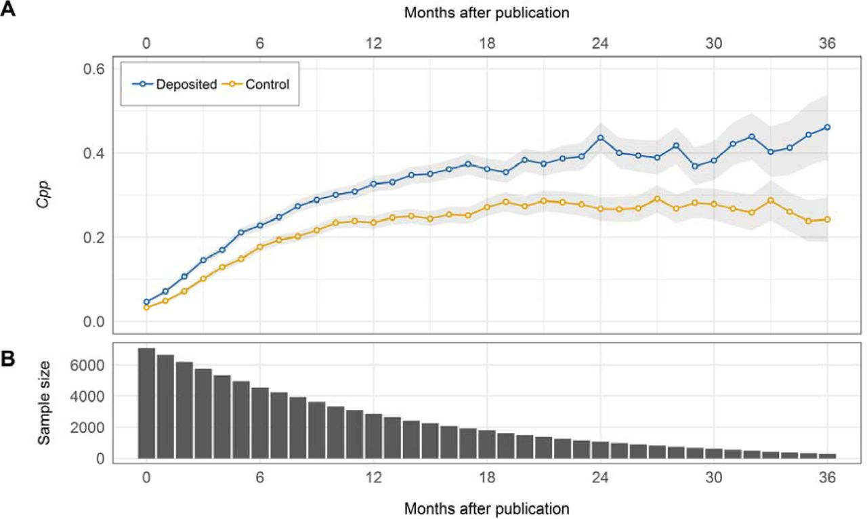
Preprints - Do they provide a citation and attention advantage?
https://www.biorxiv.org/content/10.1101/673665v1.full
(Gentil-Beccot et al. 2009)

Slide 24
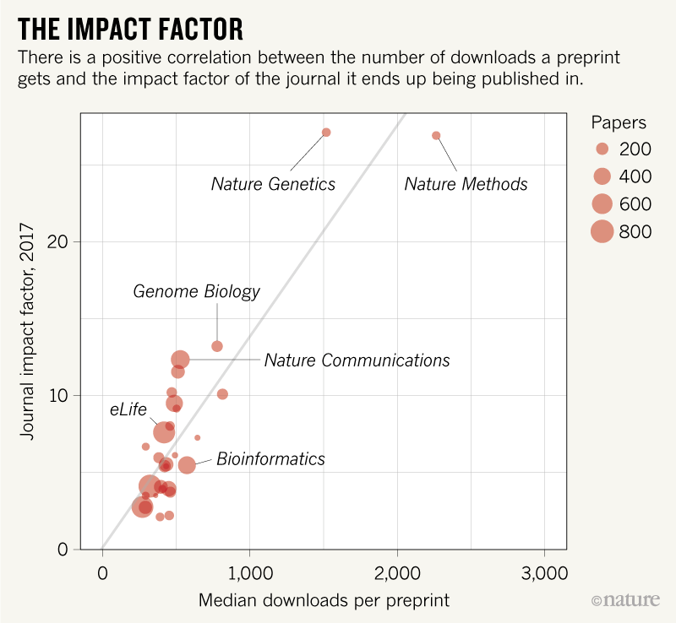
https://www.nature.com/articles/d41586-019-00199-6

Slide 25
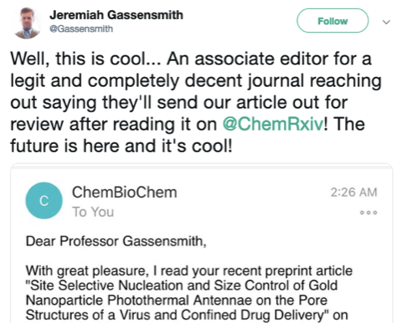
@eartharxiv
Join us, follow us!
Make your work BETTER!
Preprints are turning
around the publishing
system

Slide 26
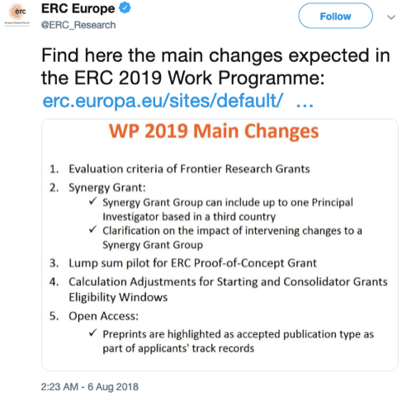
@eartharxiv
Join us, follow us!
Make your work VISIBLE!
Preprints allow you to show your preliminary work
Ideal for grant submissions and career opportunities

Slide 27

You should consider submitting a preprint if:
You are seeking to communicate your scientific findings without delay
You want everyone to have access to your work
You want feedback on your work from the community
https://medium.com/@jamesheathers/why-i-love-pre-prints-9d727eeb22b8
Publishing pre-prints sends a message I want to send. They say I am willing to talk. They say I want to participate in open culture. Please read my stuff.

Slide 28

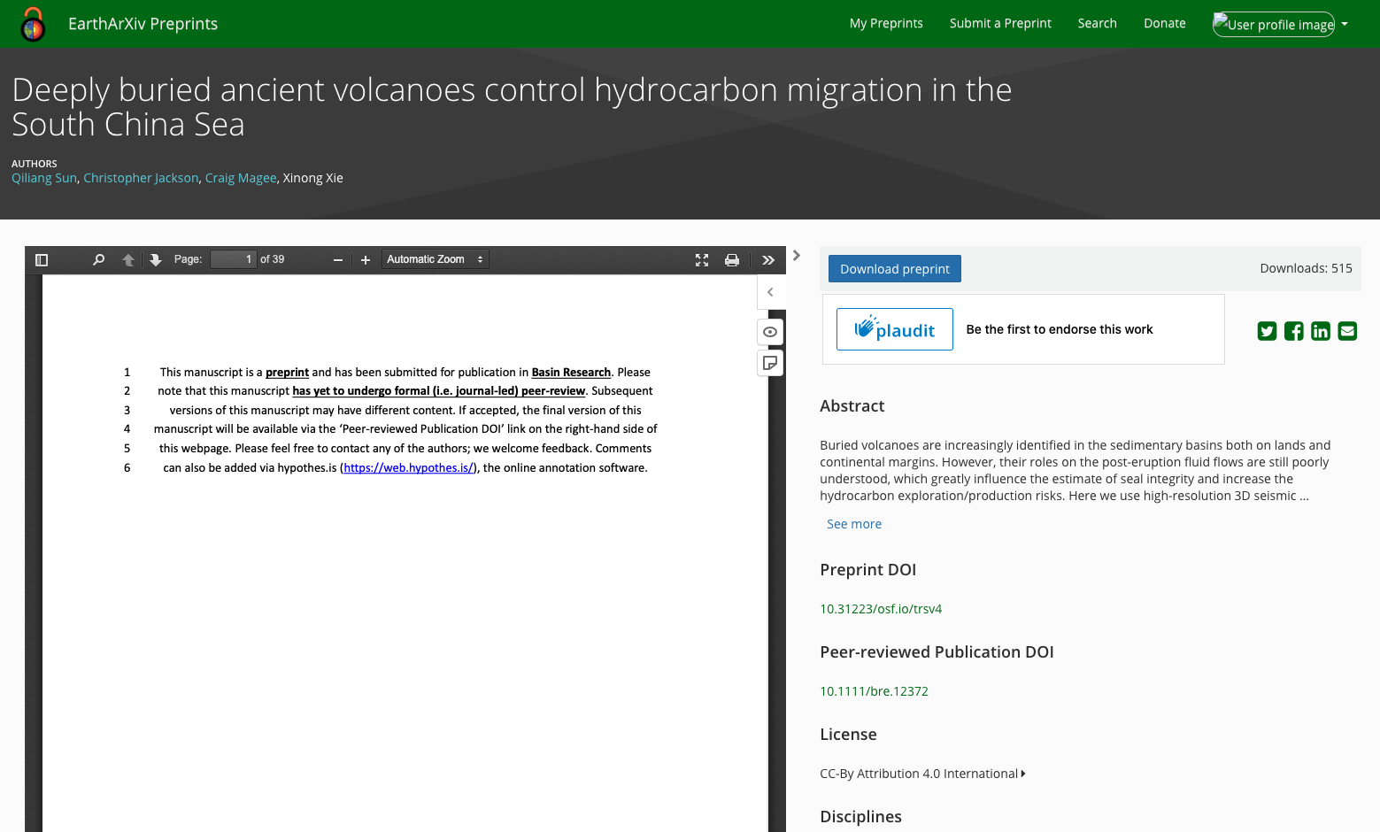

EarthArXiv.org
Commenting
Hypothes.is allows peer feedback, and helps foster collaboration and transparency in scientific research practices

Slide 29








Support from funders

Slide 30







Support from universities

Slide 31
EarthArXiv.org
Get in touch!
https://eartharxiv.github.io
Resources, including this presentation
@eartharxiv
@eartharxiv
www.eartharxiv.org
tnarock@ndm.edu
c.jackson@imperial.ac.uk

Slide 32

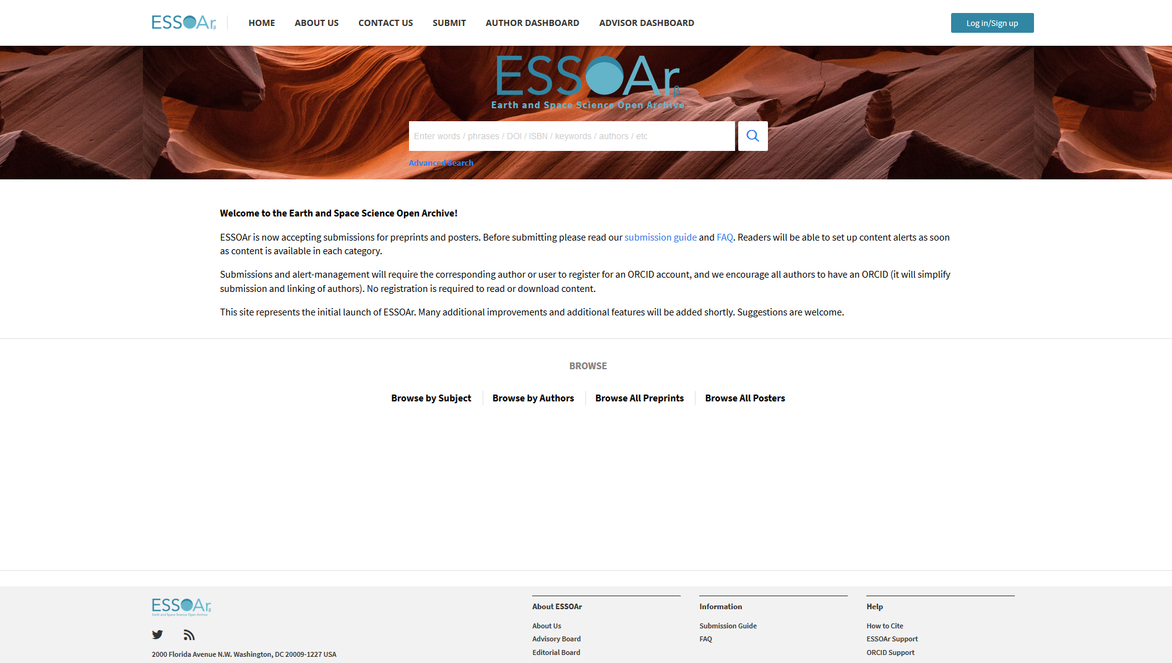
Not the only kid on the block…
Covers similar themes
Not community-led
Built on the Wiley-owned Atypon infrastructure
Increased focus on posters vs. papers

Slide 33


With initial support from the Earth Science Information Partners (ESIP), EarthArXiv coalesced into a formal group and began hosting with the Center for Open Science (COS)
COS is a non-profit technology organization based in Charlottesville, Virginia with a mission to, "increase the openness, integrity, and reproducibility of scientific research.”.
Founded in 2013 by Brian Nosek and Jeffrey Spies, and originally focused on reproducibility of psychology research
Funded by the Laura and John Arnold Foundation and many, many others
Developed and utilises the Open Science Framework

Slide 34


OSF Preprints and the OSF supporting it are public goods infrastructure with open-source code at the COS GitHub repo
10,000+ preprints currently hosted directly on the OSF across c. 19, co-searchable services
Powered by SHARE (share.osf.io), OSF Preprints aggregates search across local and external preprint services
Currently >2M preprint records available

Slide 35


EarthArXiv is moving Fall 2020...
Janeway software system hosted by the California Digital Library

Slide 36
FAQ
Answer
Will someone steal my work in my preprint?
Based on experiences at very established (e.g. ArXiv) and newer, but rapidly growing preprint services (e.g. BioArXix, SocArXiv), there is no evidence that preprints lead to being scooped.
If someone is prepared to steal ideas from a timestamped/’DOI’d’ preprint, they would likely do the same from material in a journal or from a conference presentation.
The reputational damage associated with intellectual theft is significant and long-lasting, thus the latter is very rare.
Will preprints lead to large volumes of low-quality material on EarthArXiv?
Can EarthArXiv only host preprints?
Will publishing a preprint mean I can’t publish in a journal?
How do I link data to my preprint?
Does my preprint get a DOI and how might this impact citation count?

Slide 37
FAQ
Answer
Will someone steal my work in my preprint?
Anecdotal evidence suggests this behavior has not emerged in the physics community via use of ArXiv
Because preprinting requires public disclosure, authors are wary of developing a bad reputation; if the work is poor, it will likely be ignored by the rest of the community...with the same applying to material published in a journal
RSS feeds allow sorting of material posted to EarthArXiv; cf. Google Scholar
Initial evidence and download statistics suggests EarthArXiv is hosting high-quality, desirable material...
Will preprints lead to large volumes of low-quality material on EarthArXiv?
Can EarthArXiv only host preprints?
Will publishing a preprint mean I can’t publish in a journal?
How do I link data to my preprint?
Does my preprint get a DOI and how might this impact citation count?

Slide 38
FAQ
Answer
Will someone steal my work in my preprint?
No. EarthArXiv is also a repository for postprints (i.e. material already published in a journal)
Depending on journal policy, we can host the Author Accepted Manuscript (i.e. accepted version of paper, but before publisher typesetting) (AAMs) or the Version of Record (VoR) (i.e. published version of paper, after publisher typsetting)
Check your journal’s policy on SHERPARoMEO
EarthArXiv can also host datasets, textbooks, book chapters, etc. Please contact us if you have any queries!
Will preprints lead to large volumes of low-quality material on EarthArXiv?
Can EarthArXiv only host preprints?
Will publishing a preprint mean I can’t publish in a journal?
How do I link data to my preprint?
Does my preprint get a DOI and how might this impact citation count?

Slide 39
FAQ
Answer
Will someone steal my work in my preprint?
In most cases, the answer is ‘no’; because preprinting has been ongoing in other disciplines for, in some cases, a few decades, many publishers have preprint-friendly policies already in place for their journals
Check your journal’s policy on SHERPARoMEO
Will preprints lead to large volumes of low-quality material on EarthArXiv?
Can EarthArXiv only host preprints?
Will publishing a preprint mean I can’t publish in a journal?
How do I link data to my preprint?
Does my preprint get a DOI and how might this impact citation count?

Slide 40
FAQ
Answer
Will someone steal my work in my preprint?
Open Science Framework’s infrastructure allows unlimited disk space for uploading of publication-related data (N.B. there is a per file upload limit of 5GB)
More commonly, data, and especially large volumes of data, are stored on external sites (e.g. Dropbox, GitHub, figshare, Google Drive) and linked back to the related preprint/postprint
Will preprints lead to large volumes of low-quality material on EarthArXiv?
Can EarthArXiv only host preprints?
Will publishing a preprint mean I can’t publish in a journal?
How do I link data to my preprint?
Does my preprint get a DOI and how might this impact citation count?

Slide 41
FAQ
Answer
Will someone steal my work in my preprint?
Preprints minted with a DOI upon submission
The EarthArXiv-assigned DOI will persist even if the research is eventually published in a journal
Preprints can collect citations, which count towards H-Index
Citations could, in theory, be split between preprint and VoR; the solution to this is to simply aggregate the citations
Note that the preprint can direct readers to the published version (Version of Record or ‘VoR’); evidence indicates researchers typically cite the latter and not the former
Will preprints lead to large volumes of low-quality material on EarthArXiv?
Can EarthArXiv only host preprints?
Will publishing a preprint mean I can’t publish in a journal?
How do I link data to my preprint?
Does my preprint get a DOI and how might this impact citation count?

